Slide 1
DBA MF Metrics Data Collection:
DB2 DASD METRICS TOOL
Distribution Project

Slide 2
Team Members
Alan Faragher
  Original Tool designer / Current code support
JoAnn Lizakowski
  Documentation creator
  Co-creator of common distribution EJCL
  SLCT DB (DB2 MF) Metrics rep
  SLCT DB (DB2 MF) Tools rep
Rodger Gillihan
  Co-creator of common distribution EJCL
  Testing coordinator of Prototype deliverables

Slide 3

GOALS / BENEFITS
Provide a common DBA Mainframe Tool to collect monthly DB2 MF data for all physical DBA supported accounts.
Highly Flexible - uses common MVS products found in every environment. Handles all types of DB2 dataset conditions (ie. Multiple dataset groups, migrated datasets, orphan datasets, etc.).
Collects metrics data as defined by SLCT.
Tool has multiple uses for the DB2 MF physical DBA:
    Summarize monthly Metrics data by Account
    Custom threshold analysis
    Reorg candidate summary
    Trending data
    Baseline and growth assessment

Slide 4

Status and Plans
DB2 DASD Metrics Tool Prototype components were created, tested and presented to SLCT Metrics team. (April 2005)
9 Focals from the SLCT Metrics team tested out the latest version of tool. (Summer 2005)
Next steps:
    Convert all Accounts in Larry Webb’s Department.
    (January 2006)
    Begin transition plans to convert all Accounts by Dept in Larry Light’s organization in 2006.

Slide 5


Inventory of Tool Components
8 Components – received as E-mail attachments
    SETUP INSTRUCTIONS – MS Word document
    EJCL
      MONTHLY METRICS JOBS
        DBLssid – one run for each DB2 subsystem
        DBMssid – merges all Metrics data into one summary report
      USED ONLY DURING FIRST TIME SETUP
        VCATssid – creates the LISTC LVL cards for LISTCAT step in the DBLssid job
        DCONssid – tests the DB2 to REXX interface
    REXX Code
      LISTEXTS
      DMETRICS
      DCONNECT

Slide 6
Metrics Collection Flow
Batch job flow that runs monthly for each Account
DBLssid1 DBLssid2 DBLssid3 DBLssid4 DBLssid5
DBMcust

Slide 7
DBLssid - Overview
Description
    Creates a DB2 Exception Report & Dataset Master File using
    IDCAMS LISTCAT and DB2 Catalog information.
    Excludes all “DSN”, “DSQ” and “BMC” datasets from reporting and totals.
Job Steps summary
    Step 1 - IDCAMS
      pre-delete datasets from previous run
    Step 2 - IDCAMS
      Input: in-stream card(s) LISTC LVL(vcat.DSNDBD)
      Output: '-hlq-.VSAMALL.-lpar-.DBL-ssid-'
    Step 3 - DFSORT/SYNCSORT
      Input: '-hlq-.VSAMALL.-lpar-.DBL-ssid-'
      Output: '-hlq-.VSAMLIST.-lpar-.DBL-ssid-'
    Step 4 - TSO BATCH – run REXX code LISTEXTS
      Input: '-hlq-.VSAMLIST.-lpar-.DBL-ssid-‘
      Outputs: '-hlq-.EXTENTS.MASTER.-lpar-.DBL-ssid-'
        '-hlq-.EXTENTS.EXCEPTS.-lpar-.DBL-ssid-'

Slide 8
DBLssid - Output #1
DB2 VSAM Dataset Master File
  '-hlq-.EXTENTS.MASTER.-lpar-.DBL-ssid-‘
    Used as input to:
      DBMcust job for monthly Metrics reporting
      DB2 Summary Data store in Lori Redd’s department
      Future DBA Data Mining Repository (proposed in 2006)
    Record Layout
      DATASET NAME
      ALLOC CYLS
      EXTENTS
      CYLS USED
      % USED
      % ALLOC
      % GIGS USED
      GIG LIMIT
      LPAR
      SSID
      DB
      “TS” or “IX”
      CURRENT DATE
      # TABLES
      DSGROUP
      CUSTOMER
      2nd LINE MGR
      DEPT
      IBM DIVISION
      ENVIRONMENT TYPE
      SERVICE OFFERING
      “MF”
      “DB2UDB”

Slide 9
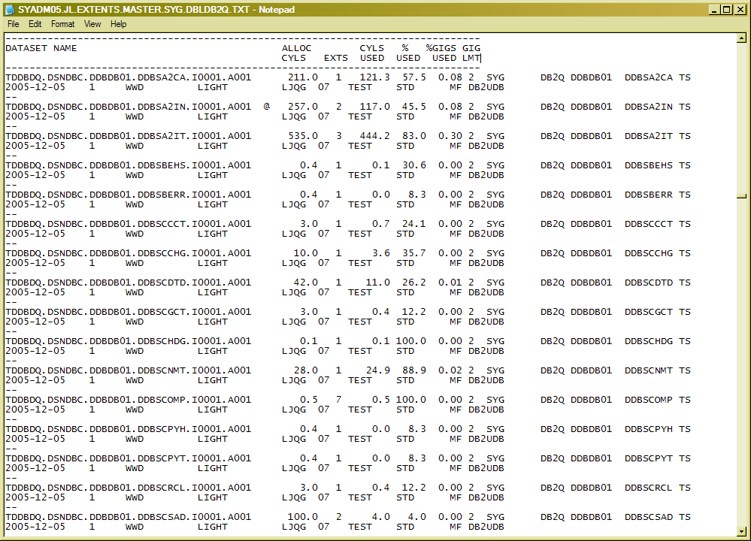
DBLssid - O/P #1 - SAMPLE
DB2 VSAM Dataset Master File (‘-hlq-.EXTENTS.MASTER.-lpar-.DBL-ssid-‘)

Slide 10
DBLssid - Output #2
DB2 VSAM Dataset Exception File – contains 2 reports
  '-hlq-.EXTENTS.EXCEPTS.-lpar-.DBL-ssid-'
    EXCEPTION REPORT – reports on DATASETS that are:
      ABOVE PRE-DEFINED EXTENT THRESHOLD (extents >= extent limit parm)
      APPROACHING GIG LIMIT (space used >= giglimit - .3)
      APPROACHING EXTENT LIMIT (extents > 225 )
      GROSSLY OVERALLOCATED (TRKS % USED <= 50% AND CYLINDERS > 200)
      ORPHAN DATASETS
      TS/IX not found in DB2 Catalog
    REORG TABLESPACES REPORT – reports all tablespaces that fit:
      SELECT T.DBNAME, T.TSNAME, I.CREATOR, I.NAME, I.CLUSTERED, I.CLUSTERING,
      I.CLUSTERRATIO, T.CARD, I.NLEAF, I.NLEVELS, DATE(I.STATSTIME)
      FROM SYSIBM.SYSINDEXES I, SYSIBM.SYSTABLES T
      WHERE I.CLUSTERING = 'Y' AND I.CLUSTERED = 'N'
      AND I.CLUSTERRATIO < 80 AND CLUSTERRATIO > 0
      AND I.TBCREATOR = T.CREATOR AND I.TBNAME = T.NAME
      AND T.CREATOR NOT IN ('SYSIBM') AND T.DBNAME NOT IN ('PLANDB')
      AND DBNAME NOT LIKE 'BMC%'

Slide 11
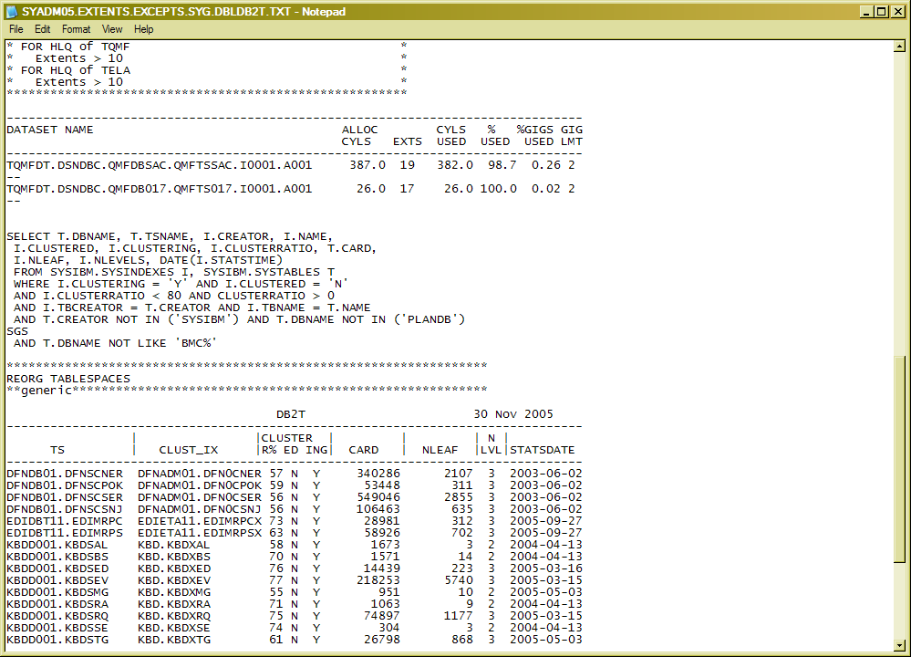
DBLssid - O/P #2 - SAMPLE
DB2 VSAM Dataset Exception File '-hlq-.EXTENTS.EXCEPTS.-lpar-.DBL-ssid-'

Slide 12
DBMcust - Overview
Description
    Does a Sort/Merge of multiple DB2 Master File datasets from several DBLssid jobs and creates one Metrics Summary report.
    Customized Database Exclusion option is available in Step 3.
Job Steps summary
    Step 1 - IDCAMS
      pre-delete datasets from previous run
    Step 2 - DFSORT/SYNCSORT
      Input(s): '-hlq-.EXTENTS.MASTER.-lpar1-.DBL-ssid1-'
        '-hlq-.EXTENTS.MASTER.-lpar2-.DBL-ssid2-‘
      Output: '-hlq-.EXTENTS.MASTER.-lpar-.DBM-ssid-'
    Step 3 - TSO BATCH – run REXX code DMETRICS
      Input: '-hlq-.EXTENTS.MASTER.-lpar-.DBM-ssid-‘
      Output(s): '-hlq-.METRICS.-lpar-.DBM-cust-.DB2'
        '-hlq-.METRICS.SUM.-lpar-.DBM-cust-.DB2'

Slide 13
DBMcust - Output #1
DB2 MF Metrics Summary Report
  '-hlq-.METRICS.-lpar-.DBM-cust-.DB2'
    TOTALS are summarized by:
      SSID
      LPAR
      CUSTOMER
      DEPARTMENT
    REPORT LAYOUT
      CUSTOMER
      LPAR
      # DB2 Subsystems
      SSID
      # DB
      TOTAL CYL
      TOTAL GIG
      # TABLES
      # TABLESPACES
      # IX
      # DATASETS

Slide 14
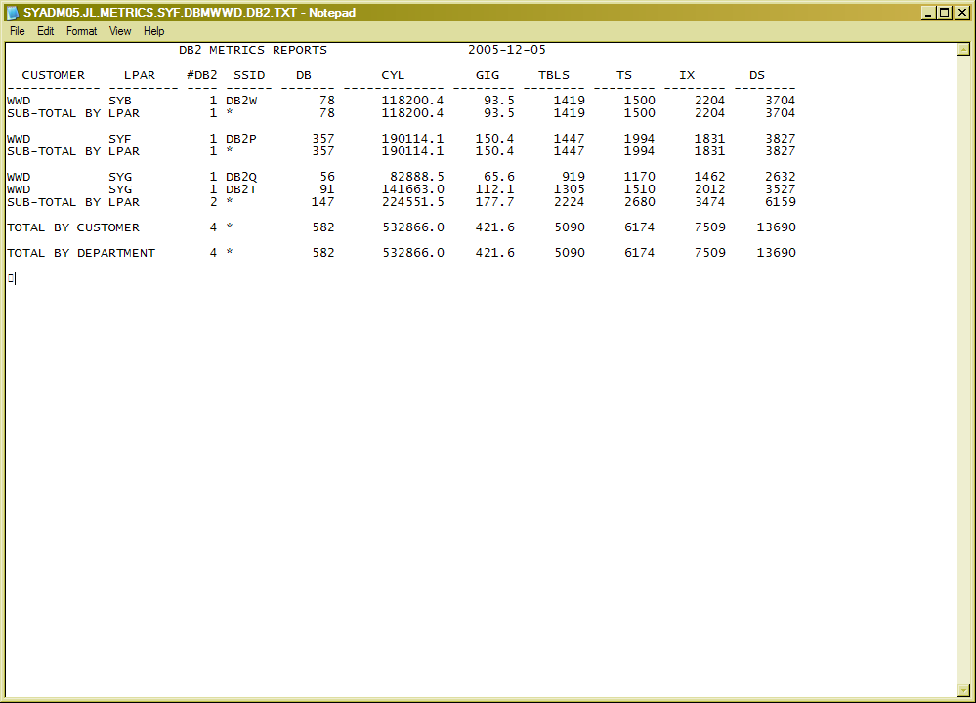
DBMcust - O/P #1 - SAMPLE
DB2 MF Metrics Summary Report '-hlq-.METRICS.-lpar-.DBM-cust-.DB2'

Slide 15
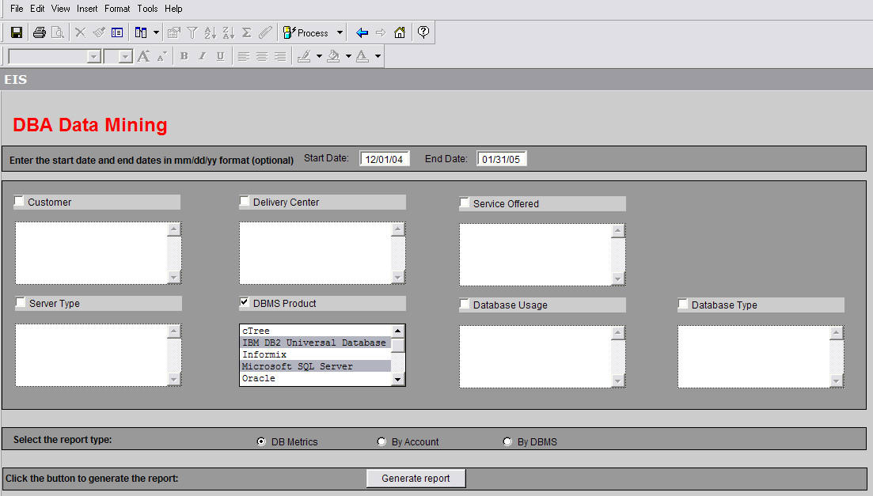
DBA Data Mining Repository – Future Data requirements

